Slide 1

Predicting Emotional Tone of Song : An NLTK Approach

Slide 2
northeastern
Agenda
01
Introduction
04
Output
02
Data Collection
05
Conclusion
03
Methodologies

Slide 3

INTRODUCTION
Music has the power to evoke emotions and influence our mood. Understanding the emotional tone of song lyrics can provide valuable insights for various applications, such as music recommendation systems and mood analysis in music therapy.
To achieve our objective, we used the Spotify API and MusixMatch API to collect song lyrics data. We then used PySpark to preprocess the data and applied various pre-trained NLP models to predict the emotional tone of the lyrics.
NORTHEASTERN
0:23
-3:25

Slide 4
Data Collection: Extracting data using Spotify API
we used the Spotify API and MusixMatch API to collect song lyrics data
We used the spotipy Python library to retrieve the track information, such as track name, artist name, and track ID, from the Spotify API using the song URLs provided by the users.
The track ID was then used to retrieve the corresponding lyrics data from MusixMatch API.
NORTHEASTERN
0:23
-3:25

Slide 5
Data Collection: Extracting data using Spotify API
Defined a user-defined function (UDF) in PySpark to preprocess the lyrics using NLTK library.
The UDF performed the following preprocessing steps:
Tokenized the lyrics
Converted all words to lowercase
Removed stopwords (common words like "the", "and", etc.)
Removed punctuation marks
Joined the cleaned tokens back into a string
Applied this UDF to the lyrics column in our PySpark DataFrame to obtain the preprocessed lyrics.
NORTHEASTERN
0:23
-3:25

Slide 6
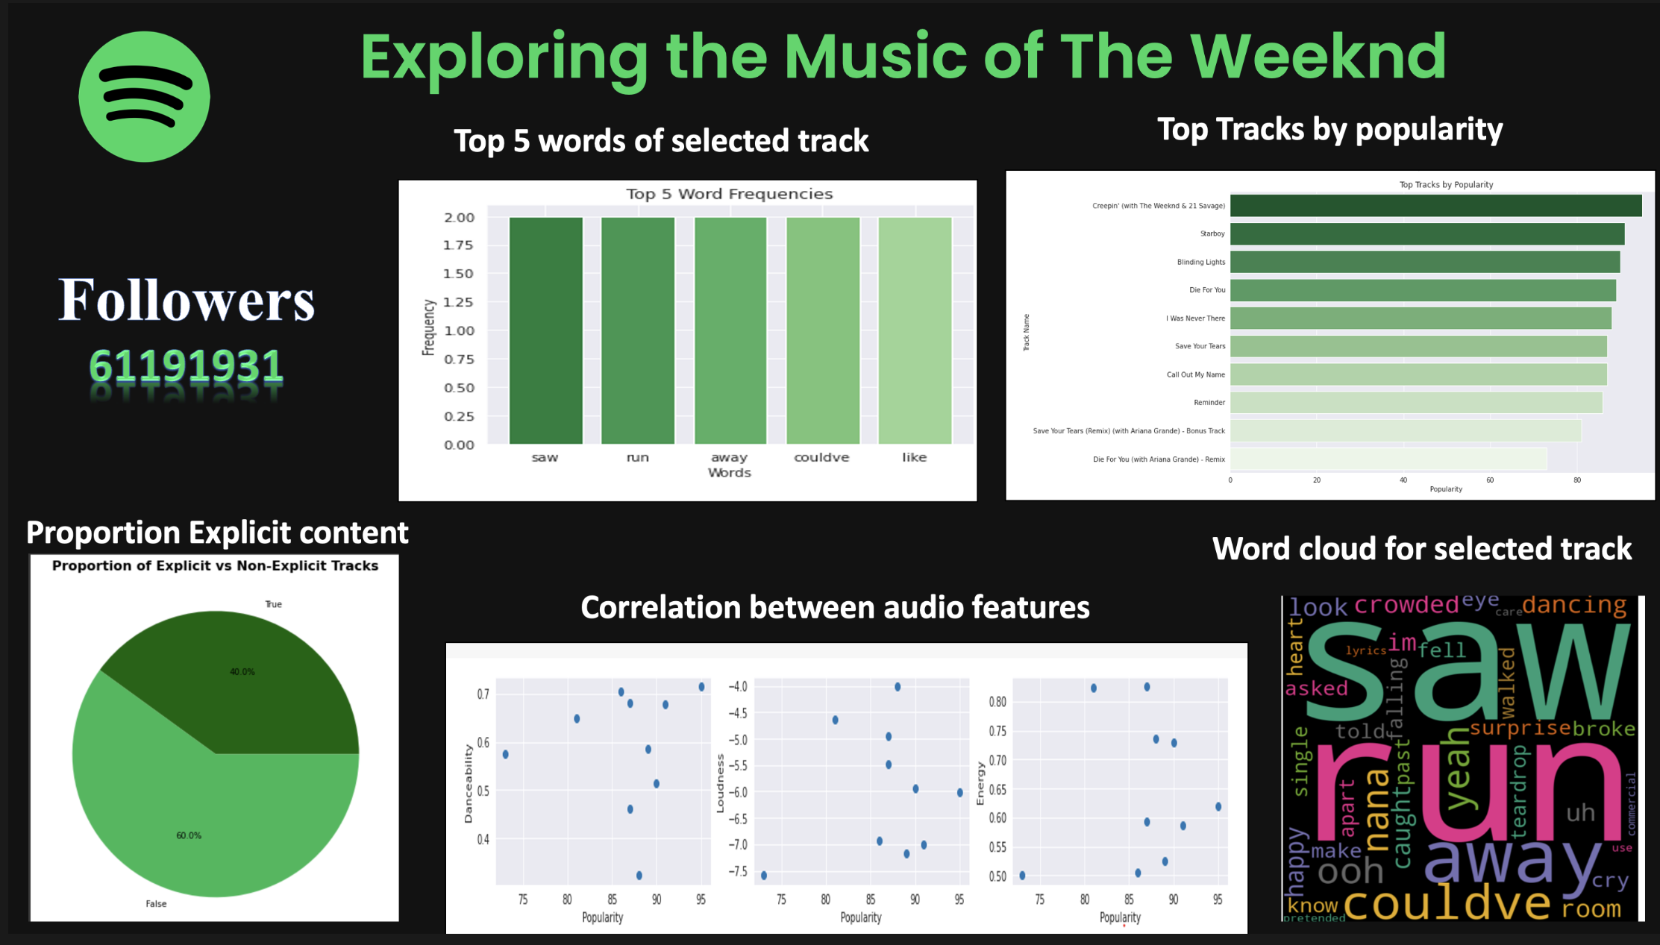
NORTHEASTERN
0:23
-3:25

Slide 7
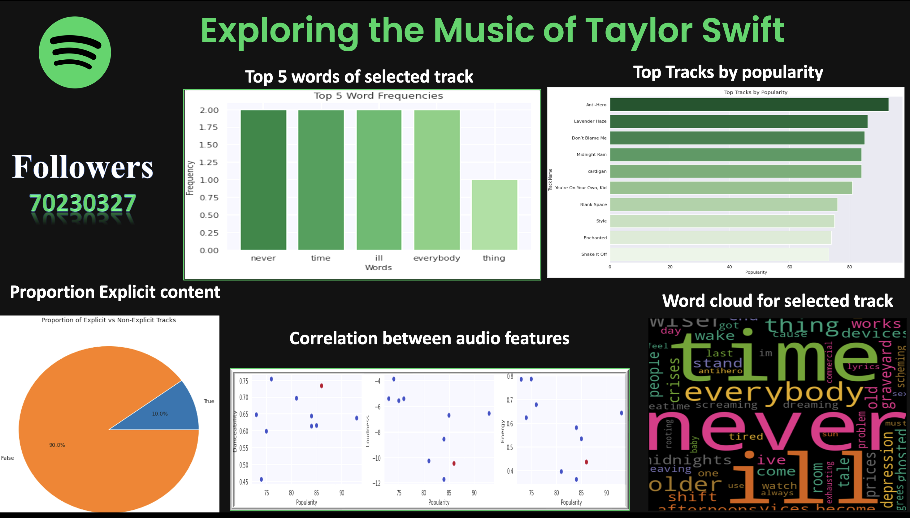
NORTHEASTERN
0:23
-3:25

Slide 8
MODEL 1: TEXT BLOB
TextBlob assigns a polarity score to each sentence in the lyrics, ranging from -1 (negative) to 1 (positive).
We calculated the mean polarity score for all the sentences in the lyrics to obtain an overall polarity score for the song.
The polarity score provides an estimate of the emotional tone of the lyrics.
NORTHEASTERN
0:23
-3:25

Slide 9
MODEL 2: VADER Sentiment Intensity Analyzer
we used the VADER Sentiment Intensity Analyzer to analyze the sentiment of song lyrics and determine the overall sentiment of each song.
The sentiment intensity score is calculated using a combination of four sentiment scores: positive, negative, neutral, and compound.
polarity is a measure of the sentiment of individual words and phrases, while compound score is a measure of the overall sentiment of a piece of text.
NORTHEASTERN
0:23
-3:25

Slide 10
MODEL 3: BERT (Bidirectional Encoder Representations from Transformers)
We used the bert-base-uncased pre-trained model for emotion classification which is has 340 million parameters.
The lyrics are tokenized using the BERT tokenizer, and the resulting tokens are passed to the BERT model.
The output of the BERT model is a vector of size 4, representing the probability distribution over the four emotion categories: angry, happy, sad, and relaxed.
We predict the emotion by taking the maximum probability and mapping it to the corresponding emotion label.
NORTHEASTERN
0:23
-3:25

Slide 11
MODEL 4: OpenAI's GPT-3
We used the OpenAI's GPT-3 (Generative Pre-trained Transformer 3) for emotion classification.
We used "text-davinci-003” model which is one of the largest and most capable language models developed by OpenAI, based on the GPT-3.5 architecture. It has 175 billion parameters.
we pass in the preprocessed lyrics as input text and prompt ChatGPT to "return emotion in a single word and return sentiment score".
NORTHEASTERN
0:23
-3:25

Slide 12
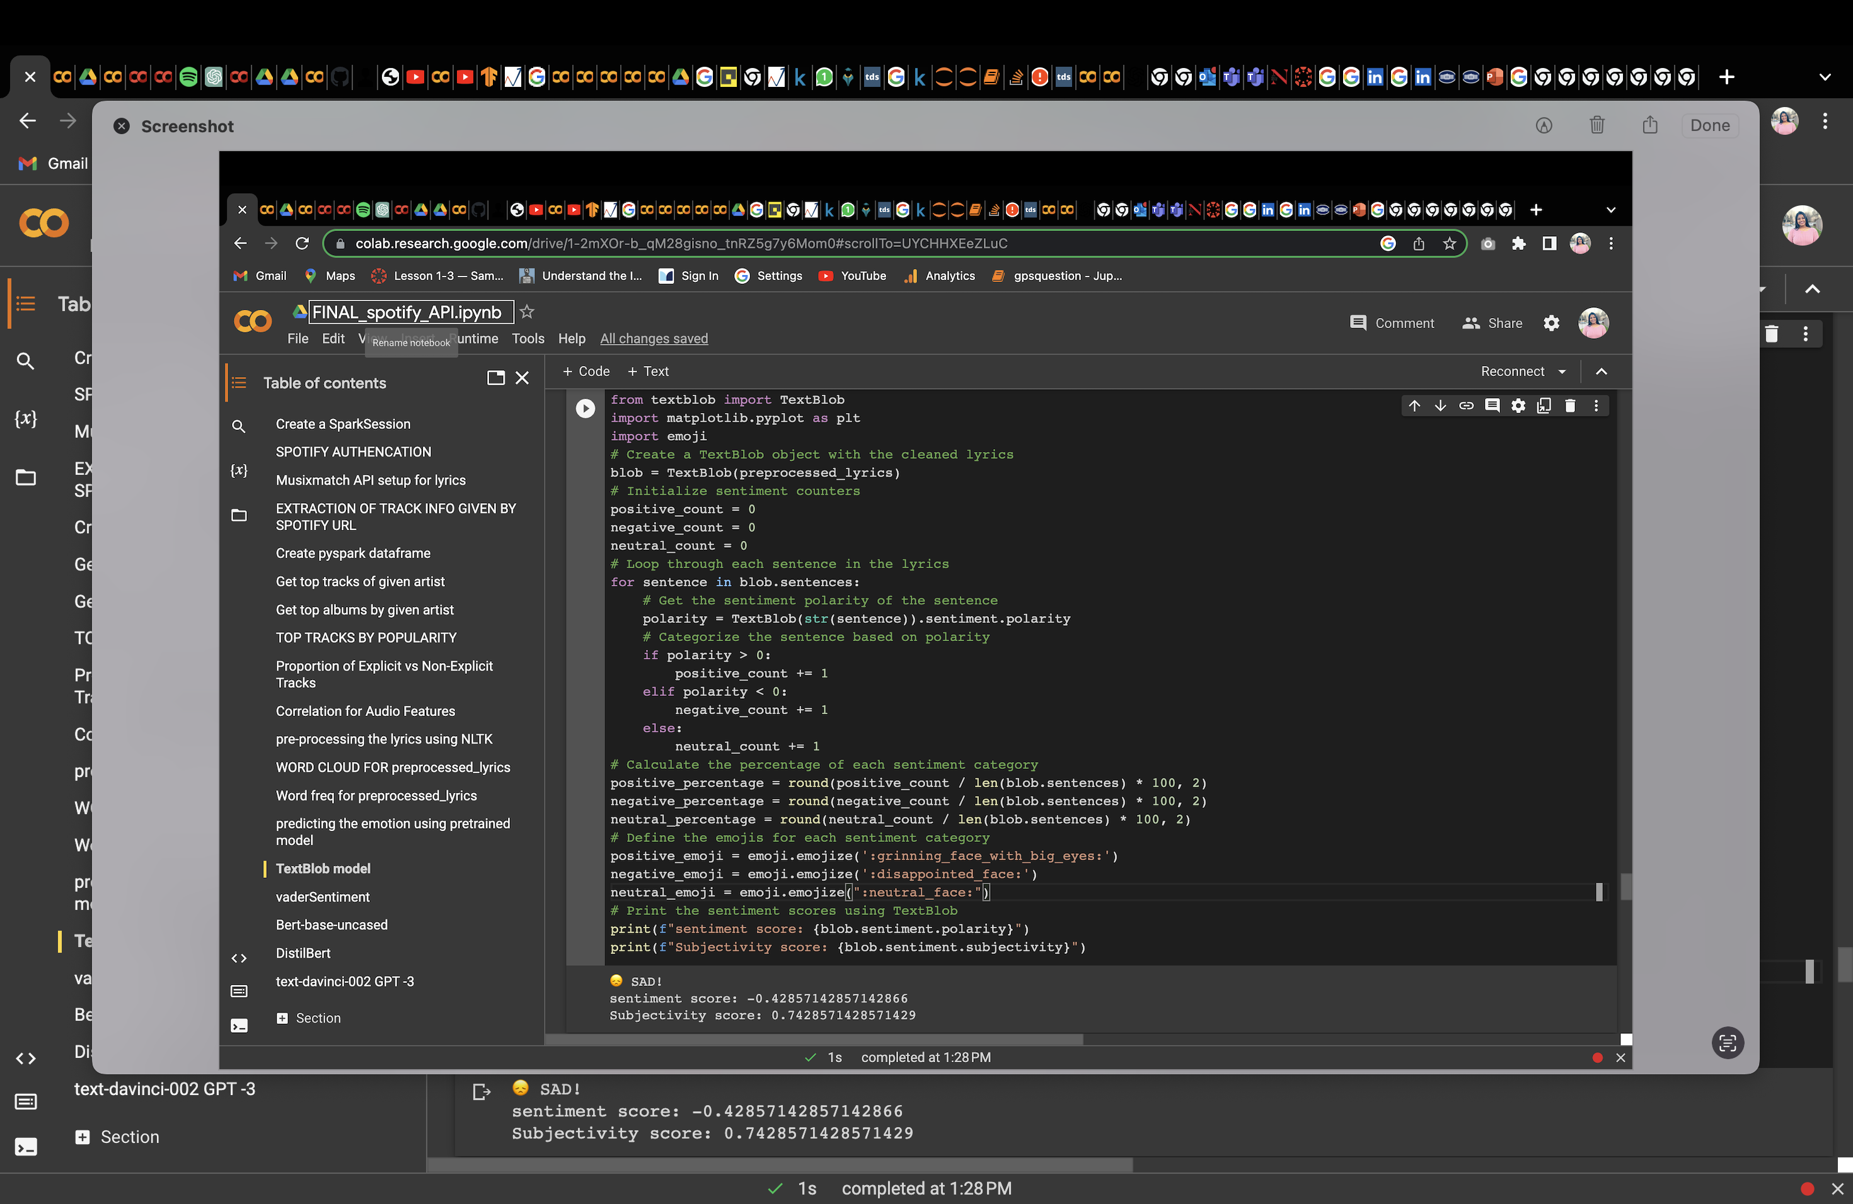
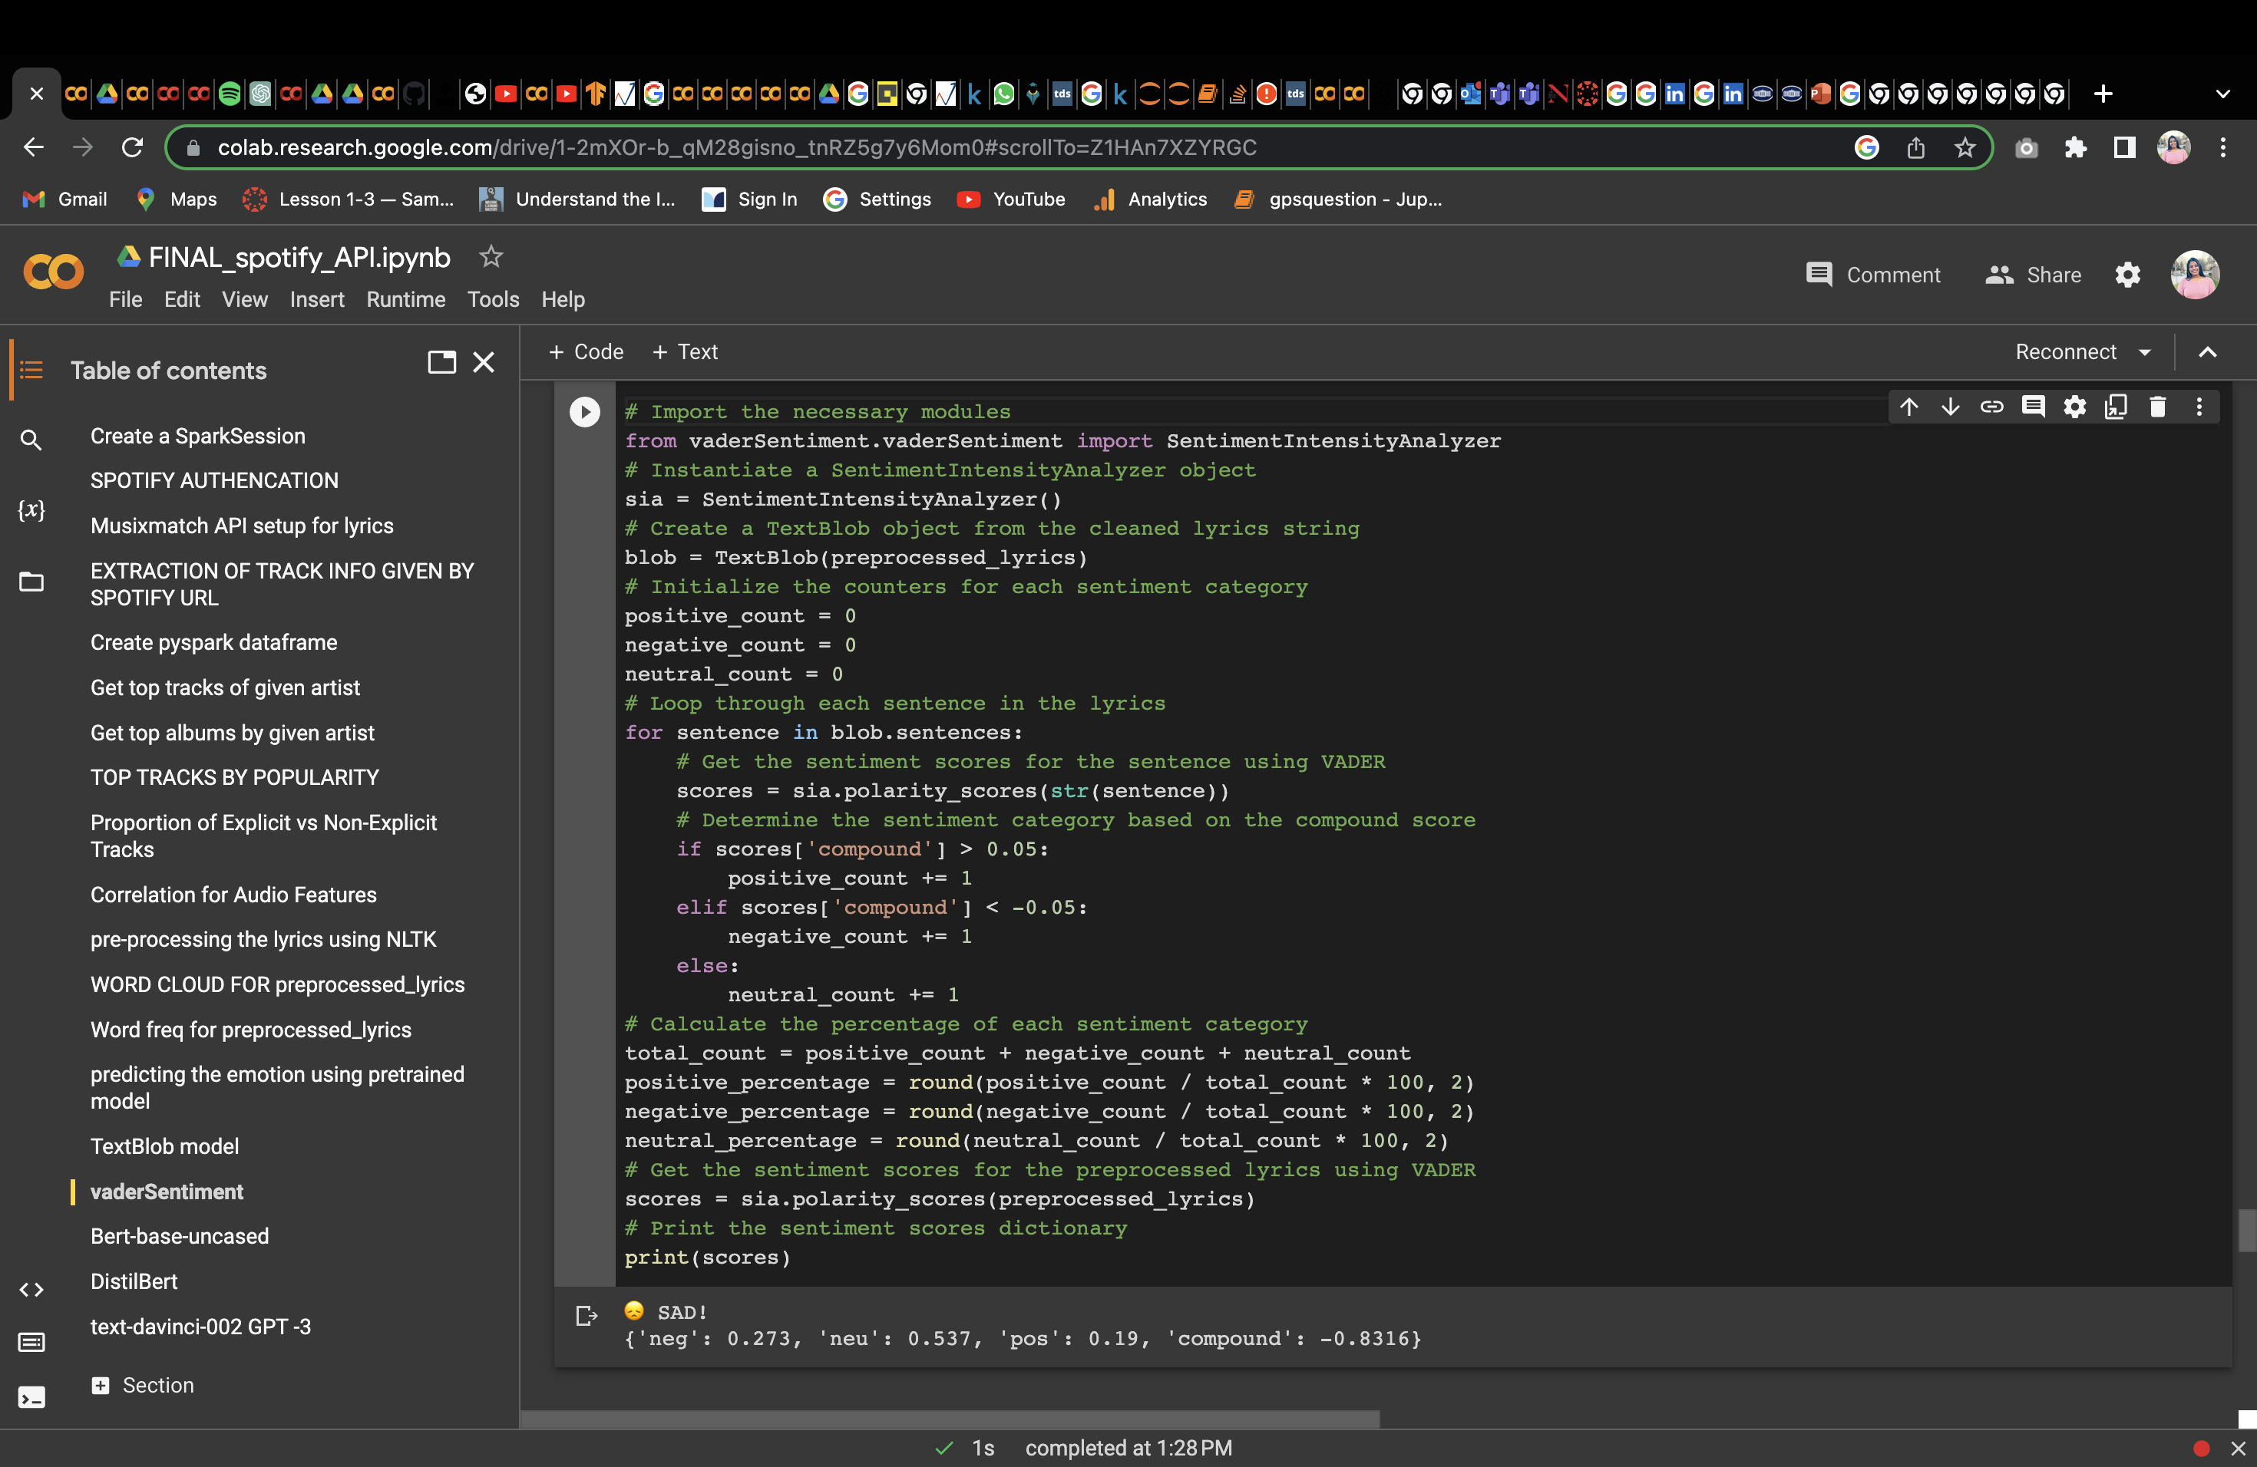
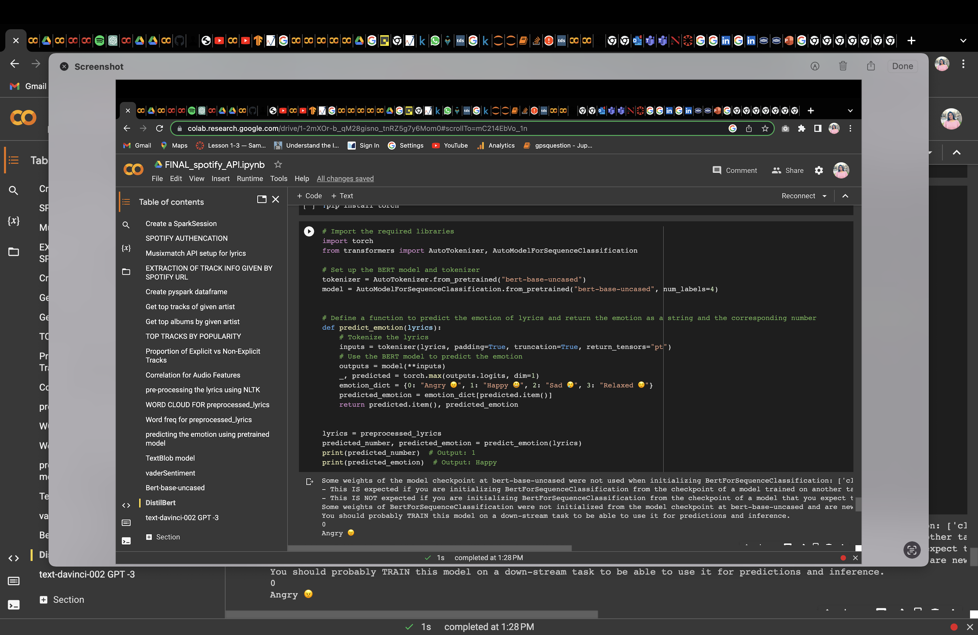
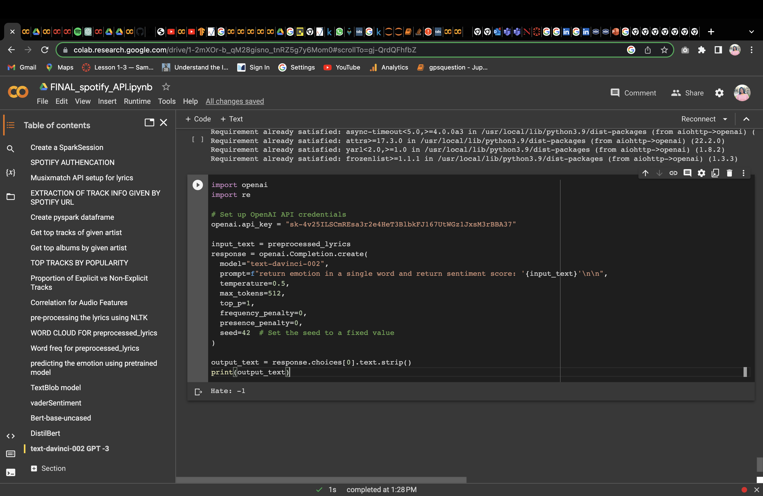
OUTPUT
The input is Before You Go Song by Lewis Capaldi
Lyrics: I fell by the wayside, like everyone else I hate you, I hate you, I hate you But I was just kidding myself Our every moment, I start to replace 'Cause now that they're gone All I hear are the words that I needed to say
MODEL 1: TEXT BLOB
MODEL 2: VADER Sentiment Intensity Analyzer
MODEL 3: BERT (Bidirectional Encoder Representations from Transformers)
MODEL 4: OpenAI's GPT-3

Slide 13
Conclusion
TextBlob and VADER are sentiment analysis tools that can provide a general sentiment score for a given text.
On the other hand, BERT and GPT are deep learning models that can predict more specific emotions and sentiments based on the context of the input text.
music streaming platforms such as Spotify and Apple Music could use these techniques to personalize playlists based on the user's emotional state or mood.
Overall, predicting the emotional tone of a song using NLP techniques has the potential to enhance the music listening experience
NORTHEASTERN
0:23
-3:25

Slide 14
Thank You

